Slide 1

FACULTY OF INFORMATION TECHNOLOGY
Fall,20172017
MAT 207- LINEAR ALGEBRA
Lecture 6 – Vector Space
12/10/2017
Lecture 3 : Matrix Algebra
1

Slide 2
Content
1
Vector Space and Subspace
Null space, Column Space and Linear Transformations
2
3
Linear Independent Sets and Bases
12/10/2017
Lecture 2 : Linear Equation in Linear Algebra
2

Slide 3
Vector Space and Subspace

Slide 4
VECTOR SPACES AND SUBSPACES
Definition: A vector space is a nonempty set V of objects, called vectors, on which are defined two operations, called addition and multiplication by scalars (real numbers), subject to the ten axioms (or rules) listed below. The axioms must hold for all vectors u, v, and w in V and for all scalars c and d.
The sum of u and v, denoted by , is in V.
.
.
There is a zero vector 0 in V such that
.

Slide 5
VECTOR SPACES AND SUBSPACES
For each u in V, there is a vector in V such that .
The scalar multiple of u by c, denoted by cu, is in V.
.
.
.
Using these axioms, we can show that the zero vector in Axiom 4 is unique, and the vector -u , called the negative of u, in Axiom 5 is unique for each u in V.

Slide 6
VECTOR SPACES AND SUBSPACES
Definition: A subspace of a vector space V is a subset H of V that has three properties:
The zero vector of V is in H.
H is closed under vector addition .That is, for each u and v in H, the sum u + v is in H.
H is closed under multiplication by scalars. That is, for each u in H and each scalar c, the vector cu is in H.

Slide 7
SUBSPACES
Properties (a), (b), and (c) guarantee that a subspace H of V is itself a vector space, under the vector space operations already defined in V.
Every subspace is a vector space.
Conversely, every vector space is a subspace (of itself and possibly of other larger spaces

Slide 8
A SUBSPACE SPANNED BY A SET
The set consisting of only the zero vector in a vector space V is a subspace of V, called the zero subspace and written as {0}.
As the term linear combination refers to any sum of scalar multiples of vectors, and Span {v₁,…,v_{p}} denotes the set of all vectors that can be written as linear combinations of v₁,…,v_{p}.

Slide 9
A SUBSPACE SPANNED BY A SET
Example 10: Given v₁ and v₂ in a vector space V, let
Show that H is a subspace of V.
Solution: The zero vector is in H, since .
To show that H is closed under vector addition, take two arbitrary vectors in H, say,
and .
By Axioms 2, 3, and 8 for the vector space V,

Slide 10
A SUBSPACE SPANNED BY A SET
So u +w is in H.
Furthermore, if c is any scalar, then by Axioms 7 and 9,
which shows that cu is in H and H is closed under scalar multiplication.
Thus H is a subspace of V.

Slide 11
A SUBSPACE SPANNED BY A SET
Theorem 1: If v₁,…,v_{p} are in a vector space V, then Span {v₁,…,v_{p}} is a subspace of V.
We call Span {v₁,…,v_{p}} the subspace spanned (or generated) by {v₁,…,v_{p}}.
Give any subspace H of V, a spanning (or generating) set for H is a set {v₁,…,v_{p}} in H such that
.

Slide 12
Null Space, Column Space and
Linear Transformation

Slide 13
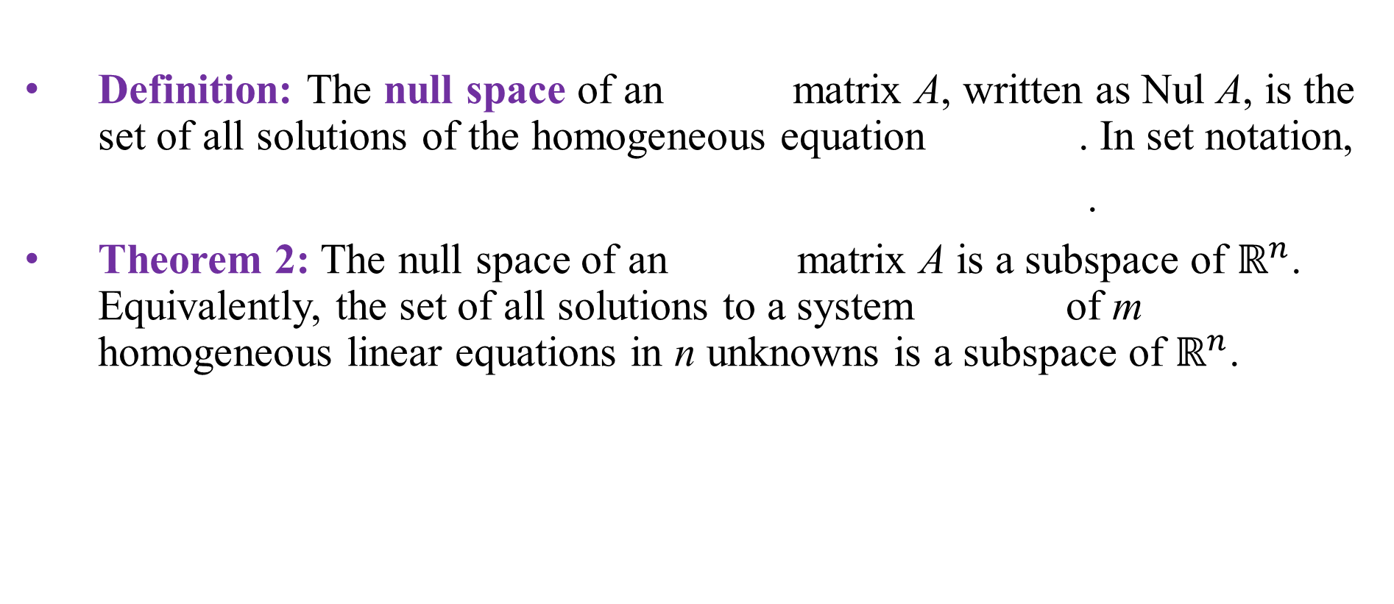
NULL SPACE OF A MATRIX
Definition: The null space of an matrix A, written as Nul A, is the set of all solutions of the homogeneous equation . In set notation,
.
Theorem 2: The null space of an matrix A is a subspace of $ℝ^{n}$. Equivalently, the set of all solutions to a system of m homogeneous linear equations in n unknowns is a subspace of $ℝ^{n}$.

Slide 14
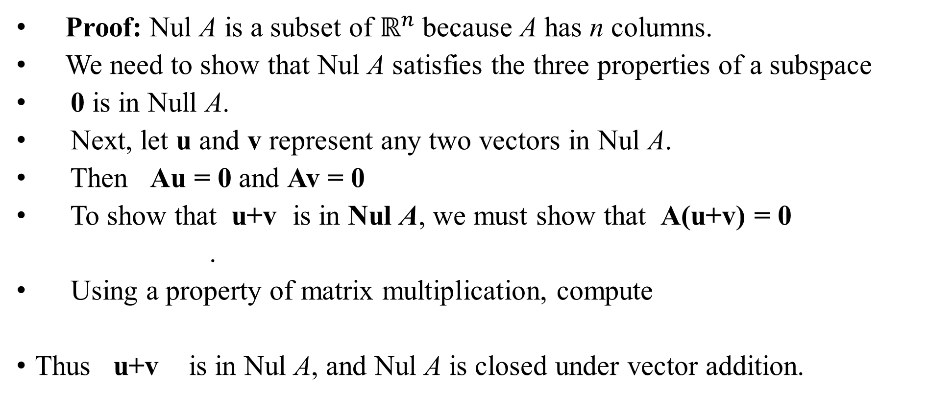
NULL SPACE OF A MATRIX
Proof: Nul A is a subset of $ℝ^{n}$because A has n columns.
We need to show that Nul A satisfies the three properties of a subspace
0 is in Null A.
Next, let u and v represent any two vectors in Nul A.
Then Au = 0 and Av = 0
To show that u+v is in Nul A, we must show that A(u+v) = 0
.
Using a property of matrix multiplication, compute
Thus u+v is in Nul A, and Nul A is closed under vector addition.

Slide 15
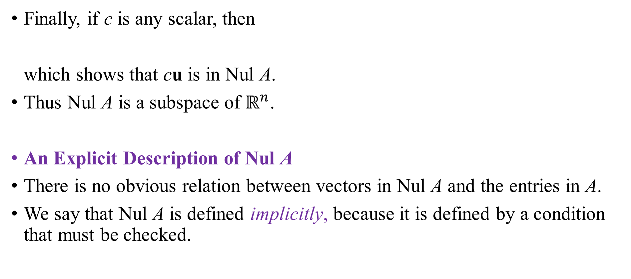
NULL SPACE OF A MATRIX
Finally, if c is any scalar, then
which shows that cu is in Nul A.
Thus Nul A is a subspace of $ℝ^{n}$.
An Explicit Description of Nul A
There is no obvious relation between vectors in Nul A and the entries in A.
We say that Nul A is defined implicitly, because it is defined by a condition that must be checked.

Slide 16
NULL SPACE OF A MATRIX
No explicit list or description of the elements in Nul A is given.
Solving the equation Ax = 0 amounts to producing an explicit description of Nul A.
Example 3: Find a spanning set for the null space of the matrix

Slide 17
NULL SPACE OF A MATRIX
Solution: The first step is to find the general solution of Ax = 0 in terms of free variables.
Row reduce the augmented matrix to reduce echelon form in order to write the basic variables in terms of the free variables:

Slide 18
NULL SPACE OF A MATRIX
The general solution is ,
with x₂, x₄, and x₅ free.
Next, decompose the vector giving the general solution into a linear combination of vectors where the weights are the free variables. That is,

Slide 19
NULL SPACE OF A MATRIX
Every linear combination of u, v, and w is an element of Nul A.
Thus {u, v, w} is a spanning set for Nul A.
Definition: The column space of an matrix A, written as Col A, is the set of all linear combinations of the columns of A. If , then

Slide 20
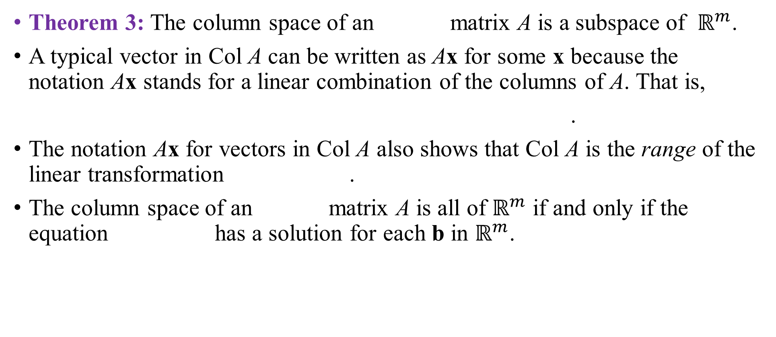
COLUMN SPACE OF A MATRIX
Theorem 3: The column space of an matrix A is a subspace of $ℝ^{m}$.
A typical vector in Col A can be written as Ax for some x because the notation Ax stands for a linear combination of the columns of A. That is,
.
The notation Ax for vectors in Col A also shows that Col A is the range of the linear transformation .
The column space of an matrix A is all of $ℝ^{m}$ if and only if the equation has a solution for each b in $ℝ^{m}$.

Slide 21
COLUMN SPACE OF A MATRIX
Example 7: Let , and
Determine if u is in Nul A. Could u be in Col A?
Determine if v is in Col A. Could v be in Nul A?

Slide 22
COLUMN SPACE OF A MATRIX
Solution:
An explicit description of Nul A is not needed here. Simply compute the product Au.

Slide 23
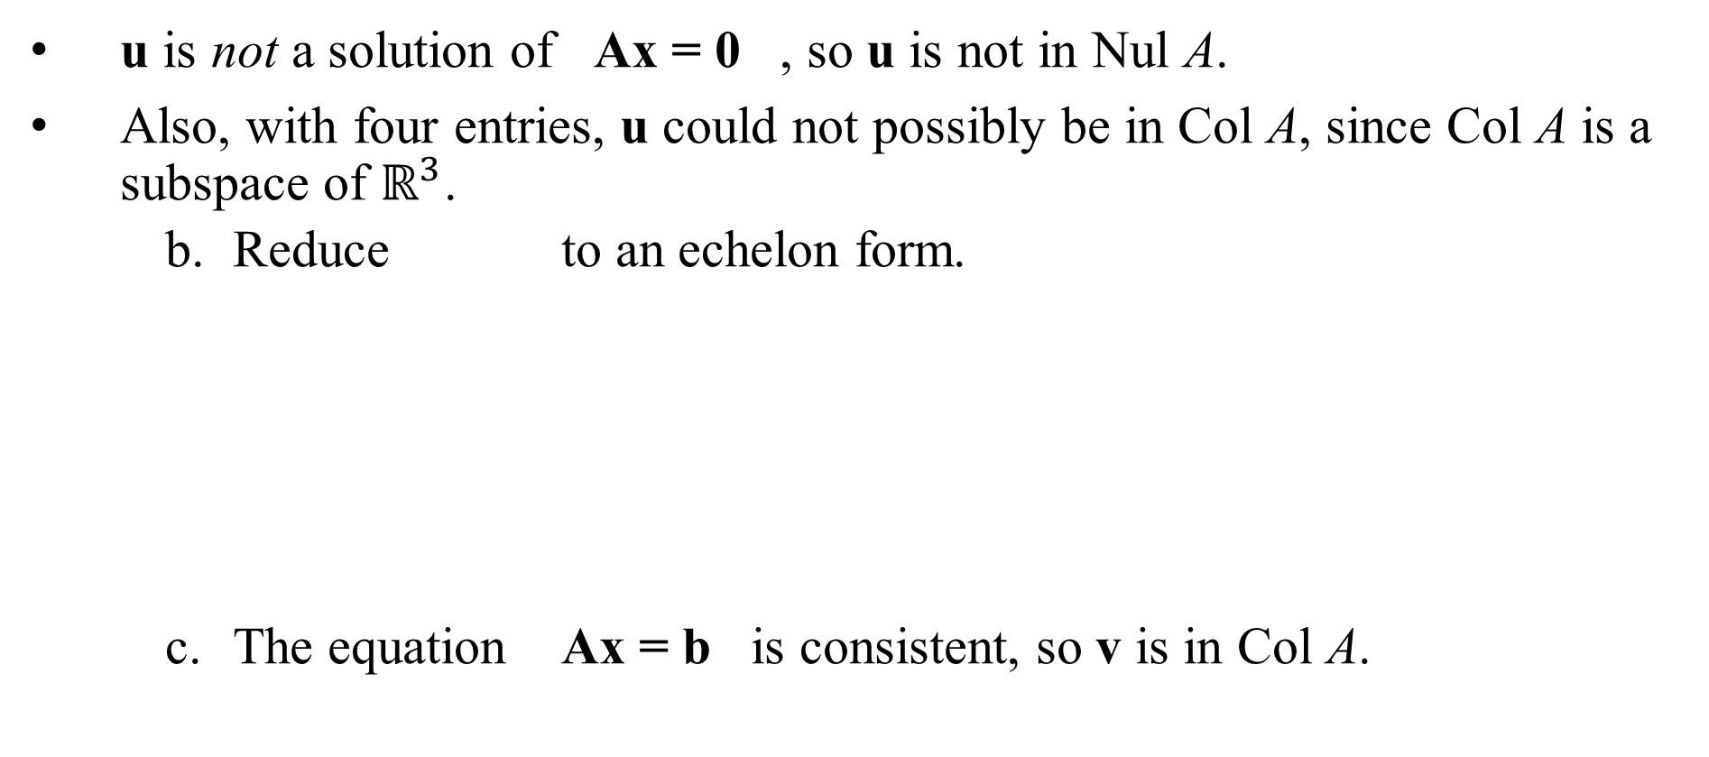
COLUMN SPACE OF A MATRIX
u is not a solution of Ax = 0 , so u is not in Nul A.
Also, with four entries, u could not possibly be in Col A, since Col A is a subspace of $ℝ^{3}$.
Reduce to an echelon form.
The equation Ax = b is consistent, so v is in Col A.

Slide 24
KERNEL AND RANGE OF A LINEAR TRANSFORMATION
Definition: A linear transformation T from a vector space V into a vector space W is a rule that assigns to each vector x in V a unique vector T (x) in W, such that
for all u, v in V, and
for all u in V and all scalars c.

Slide 25
KERNEL AND RANGE OF A LINEAR TRANSFORMATION
The kernel (or null space) of such a T is the set of all u in V such that (the zero vector in W ).
The range of T is the set of all vectors in W of the form T (x) for some x in V.
The kernel of T is a subspace of V.
The range of T is a subspace of W.

Slide 26
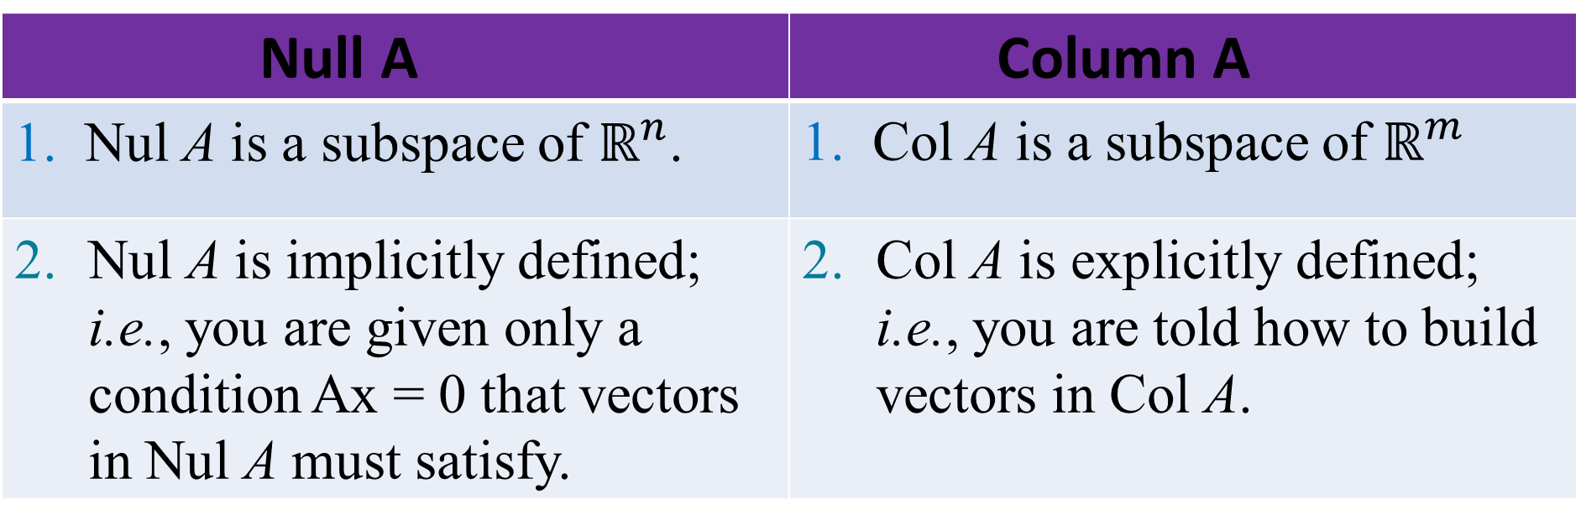
CONTRAST BETWEEN NUL A AND COL A FOR AN MATRIX A
Null A | Column A
1. Nul A is a subspace of $ℝ^{n}$. | 1. Col A is a subspace of $ℝ^{m}$
Nul A is implicitly defined; i.e., you are given only a condition Ax = 0 that vectors in Nul A must satisfy. | Col A is explicitly defined; i.e., you are told how to build vectors in Col A.

Slide 27
CONTRAST BETWEEN NUL A AND COL A FOR AN MATRIX A
3. It takes time to find vectors in Nul A. Row operations on are required. | 3. It is easy to find vectors in Col A. The columns of a are displayed; others are formed from them.
4. There is no obvious relation between Nul A and the entries in A. | 4. There is an obvious relation between Col A and the entries in A, since each column of A is in Col A.

Slide 28
CONTRAST BETWEEN NUL A AND COL A FOR AN MATRIX A
A typical vector v in Nul A has the property that Av = 0 . | 5. A typical vector v in Col A has the property that the equation is consistent.
6. Given a specific vector v, it is easy to tell if v is in Nul A. Just compare Av | 6. Given a specific vector v, it may take time to tell if v is in Col A. Row operations on are required.

Slide 29
Linear Independent Sets
and Bases

Slide 30
LINEAR INDEPENDENT SETS; BASES
An indexed set of vectors {v₁, …, v_{p}} in V is said to be linearly independent if the vector equation
(1)
has only the trivial solution, .
The set {v₁, …, v_{p}} is said to be linearly dependent if (1) has a nontrivial solution, i.e., if there are some weights, c₁, …, c_{p}, not all zero, such that (1) holds.
In such a case, (1) is called a linear dependence relation among v₁, …, v_{p.}

Slide 31
LINEAR INDEPENDENT SETS; BASES
Theorem 4: An indexed set {v₁, …, v_{p}} of two or more vectors, with , is linearly dependent if and only if some v_{j} (with ) is a linear combination of the preceding vectors, .
Definition: Let H be a subspace of a vector space V. An indexed set of vectors B in V is a basis for H if
(i) B is a linearly independent set, and
(ii) The subspace spanned by B coincides with H; that is,

Slide 32
LINEAR INDEPENDENT SETS; BASES
The definition of a basis applies to the case when , because any vector space is a subspace of itself.
Thus a basis of V is a linearly independent set that spans V.
When , condition (ii) includes the requirement that each of the vectors b₁, …, b_{p} must belong to H, because Span {b₁, …, b_{p}} contains b₁, …, b_{p}.

Slide 33

Standard Basis
Let e₁, …, e_{n} be the columns of the matrix, I_{n}.
That is,
The set {e₁, …, e_{n}} is called the standard basis for $ℝ^{n}$. See the following figure.

Slide 34
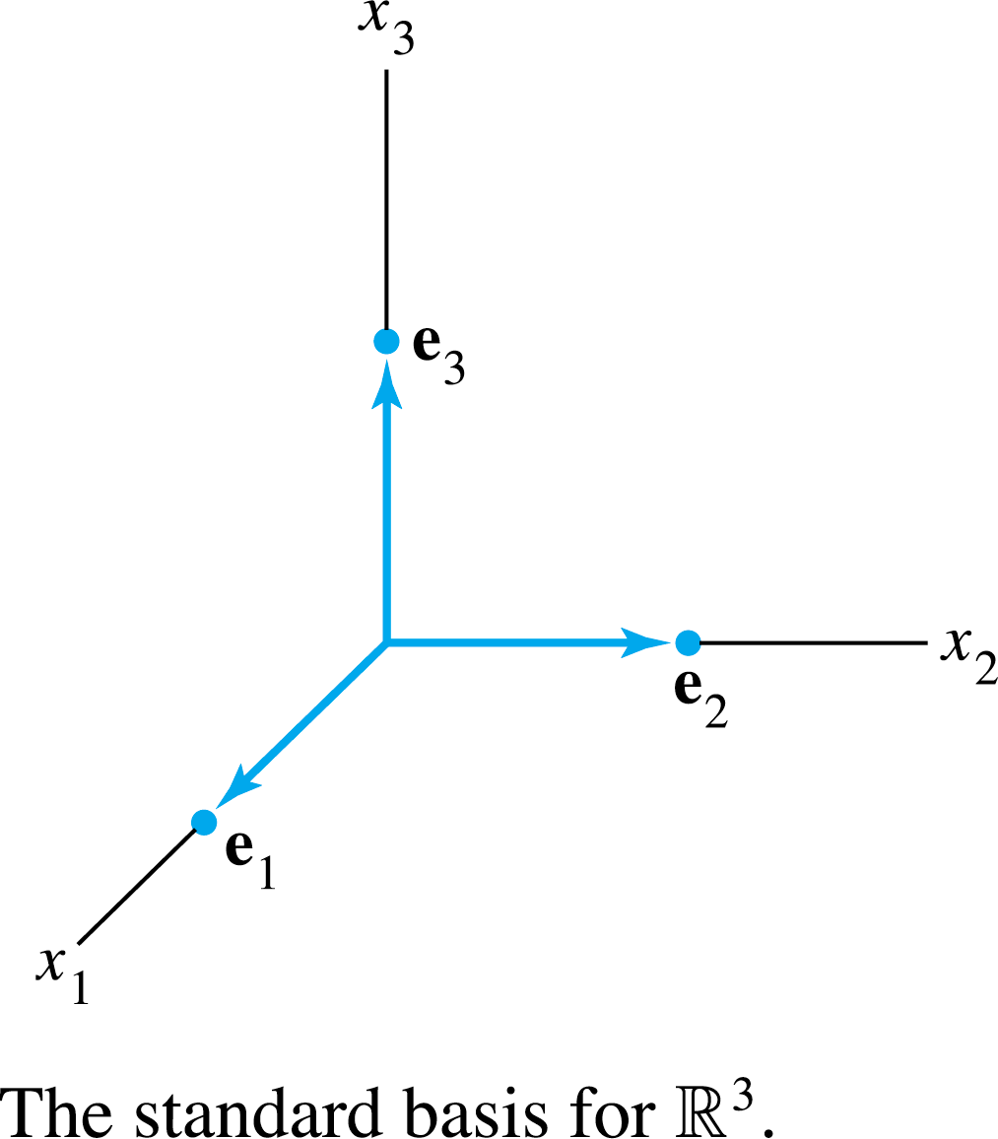
Standard Basis

Slide 35
THE SPANNING SET THEOREM
Theorem 5: Let be a set in V, and let .
If one of the vectors in S—say, v_{k}—is a linear combination of the remaining vectors in S, then the set formed from S by removing v_{k} still spans H.
b. If , some subset of S is a basis for H.

Slide 36
THE SPANNING SET THEOREM
Proof:
By rearranging the list of vectors in S, if necessary, we may
suppose that v_{p} is a linear combination of —say,
(3)
Given any x in H, we may write
(4)
for suitable scalars c₁, …, c_{p}.
Substituting the expression for v_{p} from (3) into (4), it is easy to
see that x is a linear combination of .

Slide 37
THE SPANNING SET THEOREM
Thus spans H, because x was an arbitrary element of H.
b, Try to do it Yourself

Slide 38
THE SPANNING SET THEOREM
Example 7: Let , and
and .
Note that , and show that
. Then find a basis for the subspace H.
Solution: Every vector in Span {v₁, v₂} belongs to H because

Slide 39
THE SPANNING SET THEOREM
Now let x be any vector in H—say,
.
Since , we may substitute
Thus x is in Span {v₁, v₂}, so every vector in H already belongs to Span {v₁, v₂}.
We conclude that H and Span {v₁, v₂} are actually the set of vectors.
It follows that {v₁, v₂} is a basis of H since {v₁, v₂} is linearly independent.

Slide 40
BASIS FOR COL B
Example 8: Find a basis for Col B, where
Solution: Each nonpivot column of B is a linear combination of the pivot columns.
In fact, and .
By the Spanning Set Theorem, we may discard b₂ and b₄, and {b₁, b₃, b₅} will still span Col B.

Slide 41
BASIS FOR COL B
Let
Since and no vector in S is a linear combination of the vectors that precede it, S is linearly independent. (Theorem 4).
Thus S is a basis for Col B.

Slide 42
BASES FOR NUL A AND COL A
Theorem 6: The pivot columns of a matrix A form a basis for Col A.
Proof : see textbook
Warning:
The pivot columns of a matrix A are evident when A has been reduced only to echelon form.
But, be careful to use the pivot columns of A itself for the basis of Col A.
Row operations can change the column space of a matrix.
The columns of an echelon form B of A are often not in the column space of A.

Slide 43
Thank you for listening

